Slide 1

SLR PRESENTATION
Iliescu Andrei
Iancu Aurelian
Gligor Ovidiu

Slide 2
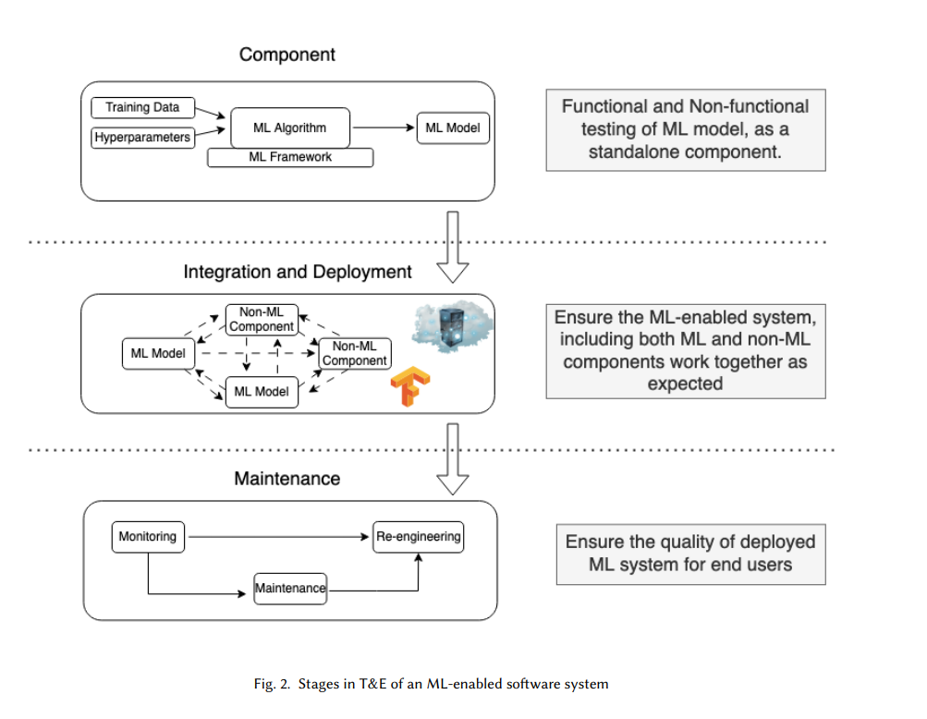
Test & Evaluation Best Practices for Machine Learning-Enabled Systems

Slide 3
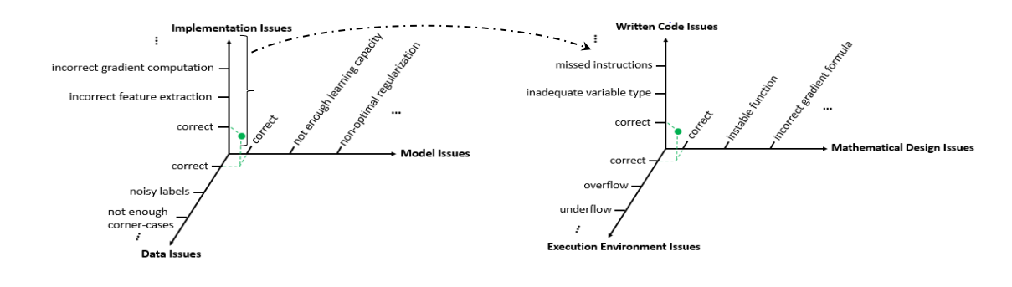
On Testing Machine Learning Programs

Slide 4
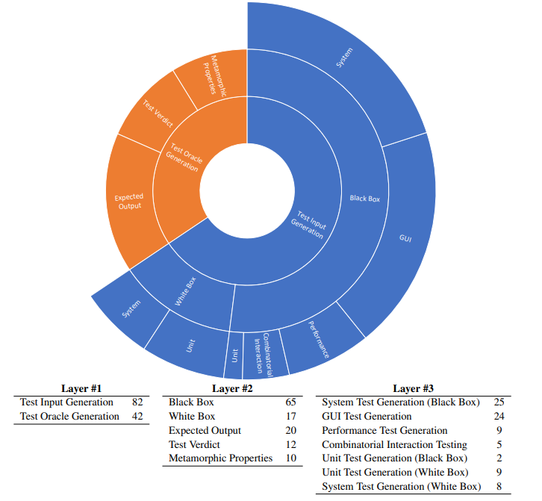
The Integration of Machine Learning into Automated Test Generation: A Systematic Mapping Study

Slide 5
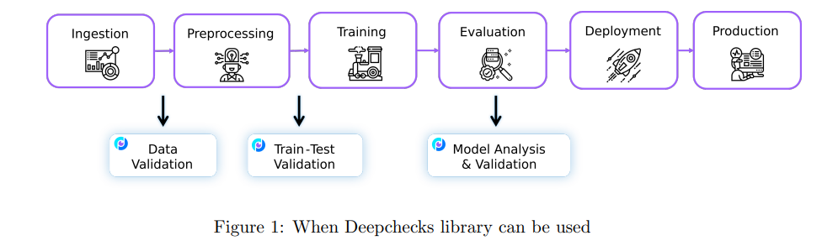
Deepchecks: A Library for Testing and Validating Machine Learning Models and Data

Slide 6
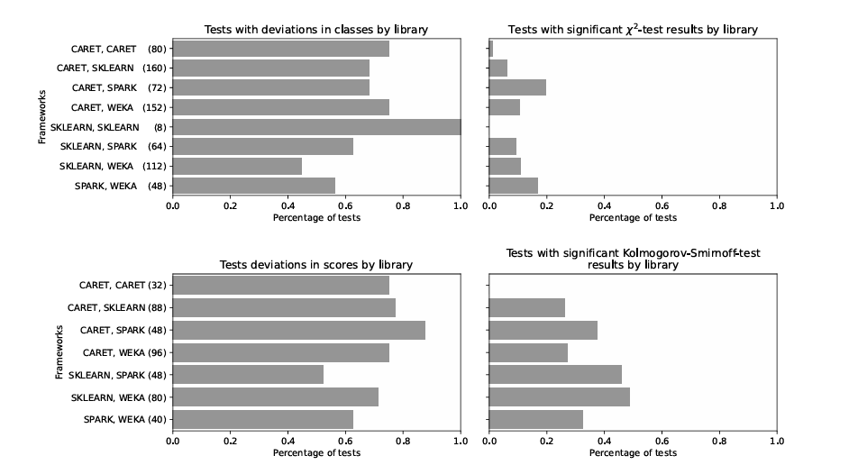
Differential Testing for Machine Learning: An Analysis for Classification Algorithms Beyond Deep Learning

Slide 7
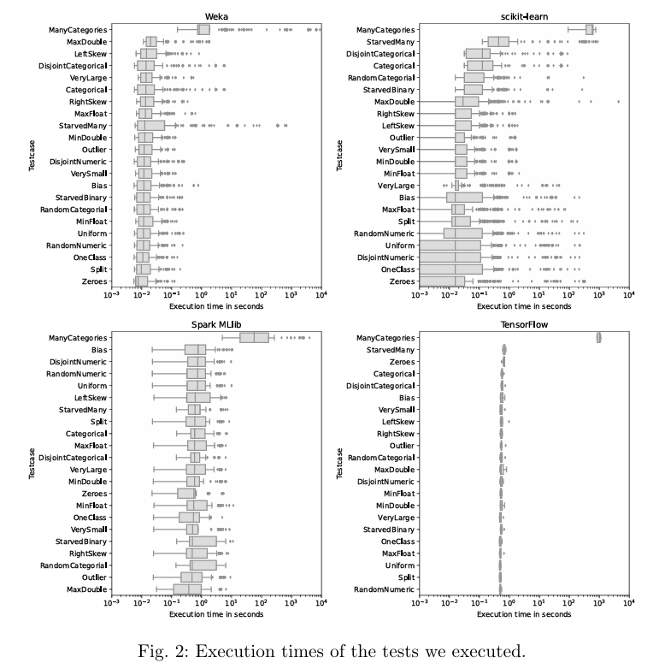
Smoke Testing for Machine Learning: Simple Tests to Discover Severe Bugs

Slide 8
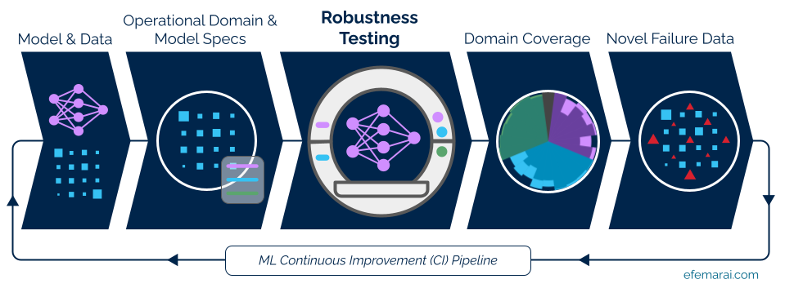
Software Testing for Machine Learning

Slide 9
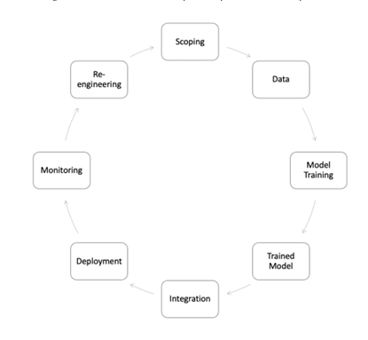
A Study of Test Suite Effectiveness in Defect Detection of Machine Learning Programs

Slide 10
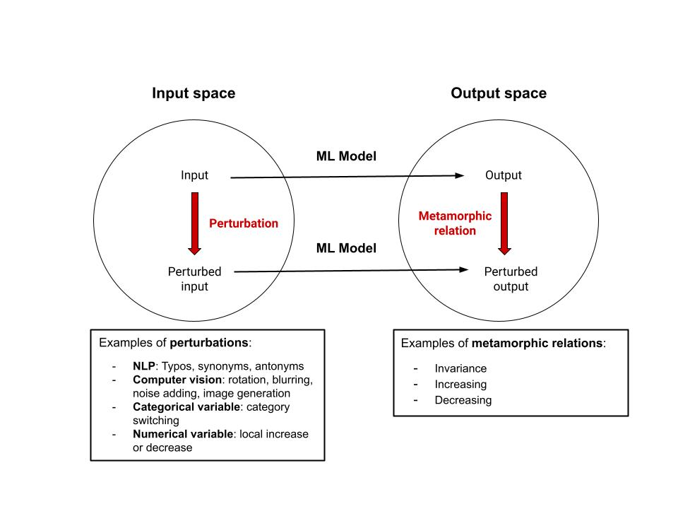
Metamorphic Testing for Machine Learning Models

Slide 11
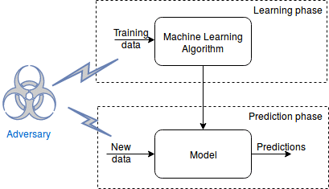
Adversarial Testing of Machine Learning Models: A Review

